Slide 1

SINGLE CODE BASE LIBRARY MANAGEMENT SYSTEM
MINI PROJECT
DATE:31-07-2021

Slide 2

TEAM MEMBERS
DEPARTMENT OF COMPUTER SCIENCE AND ENGINEERING
D.VISHAL KUMARAN - 820318104043
V.NIGASH - 820318104022
P.ANANDHARAMAN - 820318104005

Slide 3
ABSTRACT:
Online Library Management System is a system which maintains the information about the books present in the library, their authors, the members of library to whom books are issued, library staff and all. This is very difficult to organize manually. Maintenance of all this information manually is a very complex task. Owing to the advancement of technology, organization of an Online Library becomes much simple. The Online Library Management has been designed to computerize and automate the operations performed over the information about the members, book issues and returns and all other operations. This computerization of library helps in many instances of its maintenances. It reduces the workload of management as most of the manual work done is reduced, The entire proposed system is ready to be used by college and its going to have iOS, android, and web application with amazing features in single code base with the help of 4 frame works.

Slide 4
EXISTING SYSTEM:
The current Library Management System does not eliminate the process of searching books within the library campus. Students have to find books manually. The admin personal also have to look manually on which day which person will take the charge within library to manage the overall work maintenance of library catalogue and arrangement of the books to the catalogue is very complex task. In addition to its maintenance of member details, issue dates and return dates etc. manually is a complex task. All the operations must be performed in perfect manner for the maintenance.

Slide 5
PROPOSED SYSTEM:
The online Library Management System come with all the basic as well as some innovative features for managing a library. It consists of a large database of various books available in the library. It also lists various books issued to respective readers. The system keeps track of all the books readily available and also the books that have been issued to various readers for the time period for which the books have been issued. The system also handles books database. Readers usually tend to forget the date to return their library books, so this system even calculates fine depending on the expiry date. Thus, this innovative library management system provides enhanced library functionality for this modern world.

Slide 6
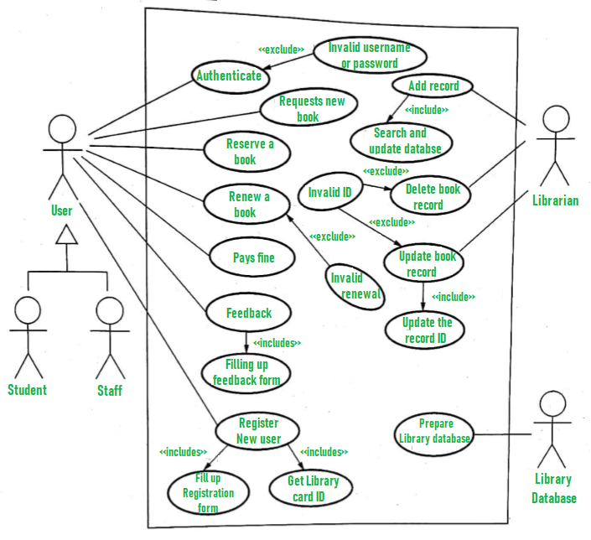
PROPOSED SYSTEM ARCHITECTURE-USE CASE

Slide 7
TECHNOLOGY STACK:
Laravel- For web application
Flutter – For android and iOS application
Version control system – git
Hosting- Heroku
Front end & scripting – html, CSS, dart, xml , yaml
Back end –php ,dart, JavaScript
Database – xampp, MySQL

Slide 8
IMPLEMENTATION:
Laravel- Laravel is a web application framework with expressive, elegant syntax
FLUTTER-Flutter is Google’s UI toolkit for building beautiful, natively compiled applications
FLUTTER-Flutter is Google’s UI toolkit for building beautiful, natively compiled applications

Slide 9

WEB FRAME WORK-LARAVEL
Laravel is a web application framework with expressive, elegant syntax. A web framework provides a structure and starting point for creating your application, allowing you to focus on creating something amazing while we sweat the details. Laravel strives to provide an amazing developer experience, while providing powerful features such as thorough dependency injection, an expressive database abstraction layer, queues and scheduled jobs, unit and integration testing, and more

Slide 10

MOBILE APP FRAME WORK-FLUTTER
Flutter is Google’s open source technology for creating mobile, desktop, and web apps with a single codebase. Unlike other popular solutions, Flutter is not a framework or library; it’s a complete SDK – software development kit. Let’s briefly clarify it here to make sure we’re on the same page. A library is basically a reusable piece of code that you put in your application to perform a certain common function. A framework is a structure that provides you with a skeleton architecture for building software

Slide 11

DATABASE-MYSQL:
MySQL Database Service is a fully managed database service to deploy cloud-native applications. MySQL Database Service is a fully managed database service to deploy cloud-native applications. Heatwave, an integrated, high-performance query accelerator that boosts MySQL performance by 400x.

Slide 12

VERSION CONTROL SYSTEM-GIT
Git is a free and open source distributed version control system designed to handle everything from small to very large projects with speed and efficiency. Git is easy to learn and has a tiny footprint with lightning-fast performance. It outclasses SCM tools like Subversion, CVS, Perforce, and Clear Case with features like cheap local branching, convenient staging areas, and multiple workflows

Slide 13

HOSTING- HEROKU
Heroku is a container-based cloud Platform as a Service (PaaS). Developers use Heroku to deploy, manage, and scale modern apps. Our platform is elegant, flexible, and easy to use, offering developers the simplest path to getting their apps to market. Heroku is fully managed, giving developers the freedom to focus on their core product without the distraction of maintaining servers, hardware, or infrastructure. The Heroku experience provides services, tools, workflows, and polyglot support all designed to enhance developer productivity.

Slide 14
SYSTEM SPECIFICATION
HARDWARE REQUIREMENTS
CPU type : Intel Core i5
Clock speed :3.0 GHz
RAM size :8 GB
Hard disk (SSD) :500 GB
SOFTWARE REQUIREMENTS
Operating System : Windows 10
IDE : Visual Studio Code, Android Studio
Language : HTML, CSS, PHP, JAVASCRIPT, DART, YAML, XML, SWIFT, MYSQL.
Version Control System : Git
Hosting : HerokuCLI

Slide 15
SYSTEM DESIGN AND MODULES:
The modules involved in the project are as follows
Application Interface
Admin Registration and Login
Student and Staff Registration
Search Book
Admin Module

Slide 16
Application Interface
Application interface is the graphical user interface module of the overall system. It consists of Librarian/admin login and registration tab and student registration and Book search Tab as the landing page for the Application
Admin Registration and Login
Using this module, the authority of the library can create their own login credentials with an ease of access, the librarian can sign out and sign in everywhere with a pc or in mobile app.
Student and staff Registration
Using This module, the end user (student/staff) can register to the library to confirm their entry to the system, their request is only approved by the librarian/admin, the student/staff can access the library when registration and approval is completed.

Slide 17
Search Book
Most scalable feature without registration login everyone can see the list of books in the library with all the details of the book
Librarian and Admin Module
The Librarian/admin has the following functionalities in the system- Login, Registration, Add Book Publication, Add Books in Library and Details, View Issued Books, All Waiting Students, All Approved Students, Add Settings, Issue/Return Books.

Slide 18
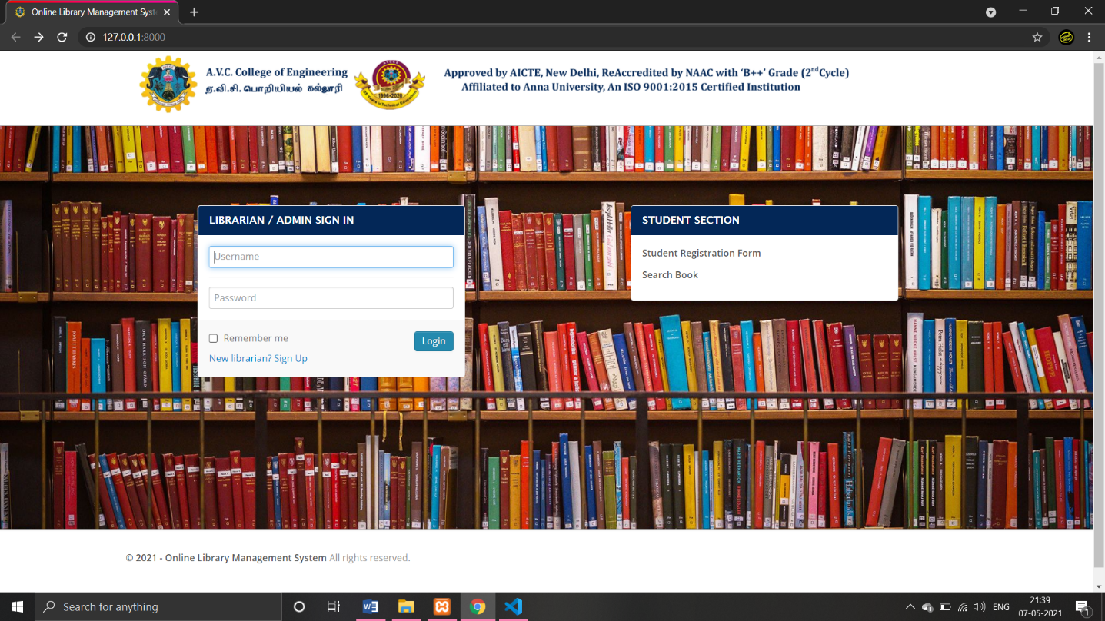
OUTPUT
Landing Page (Home Page)

Slide 19
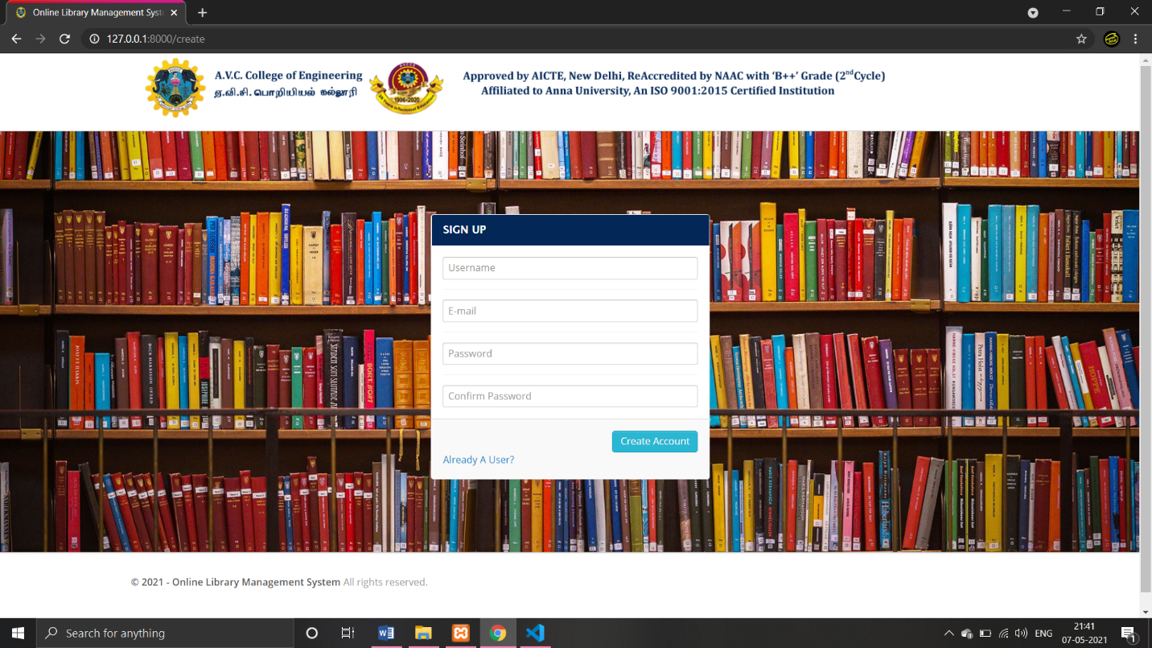
Librarian/Admin Registration page

Slide 20
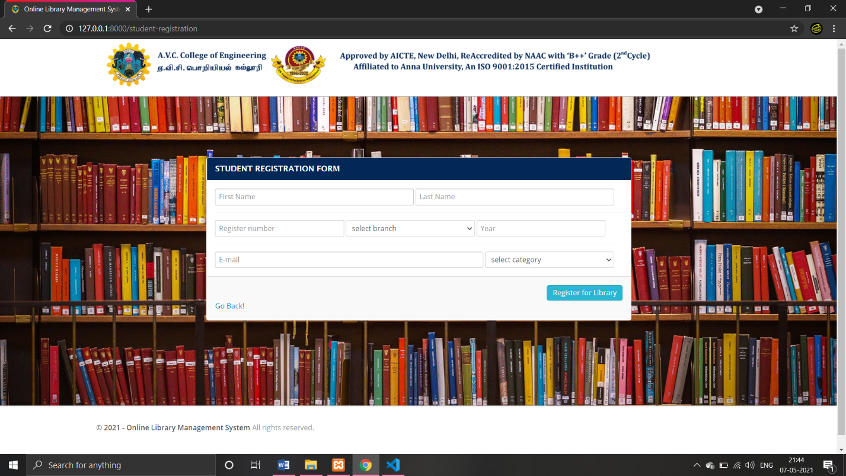
Student / Staff Registration Page

Slide 21
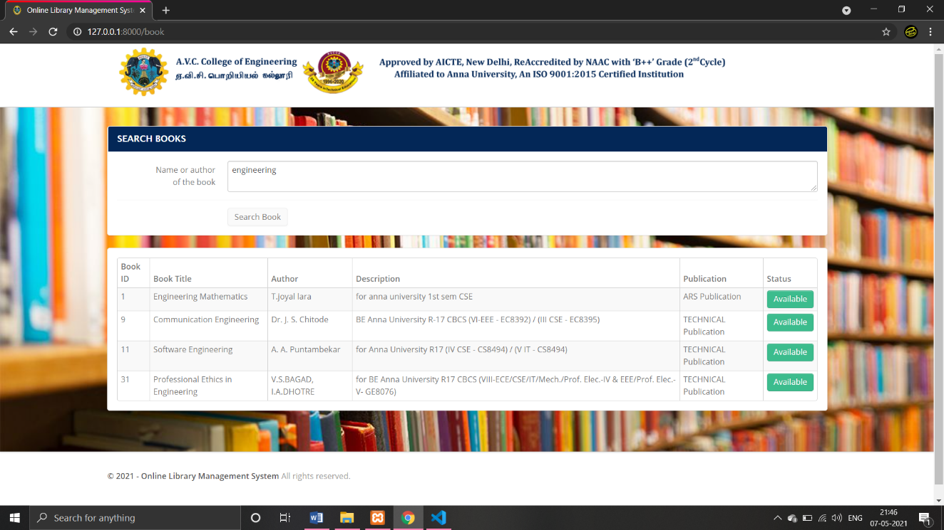
Search Book Page

Slide 22
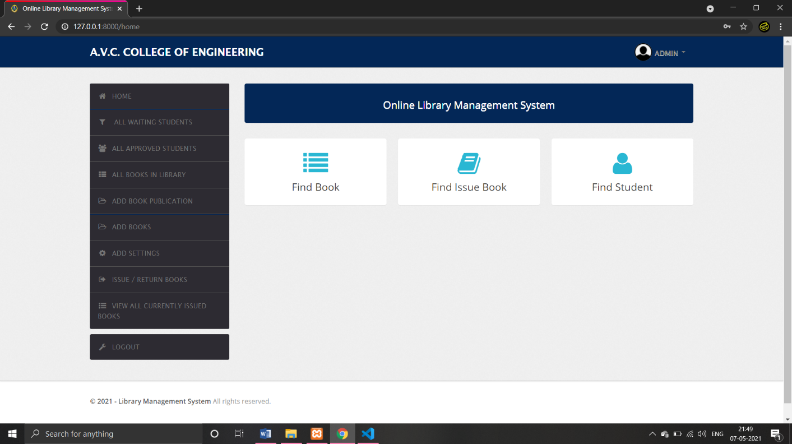
Librarian/admin Landing page

Slide 23
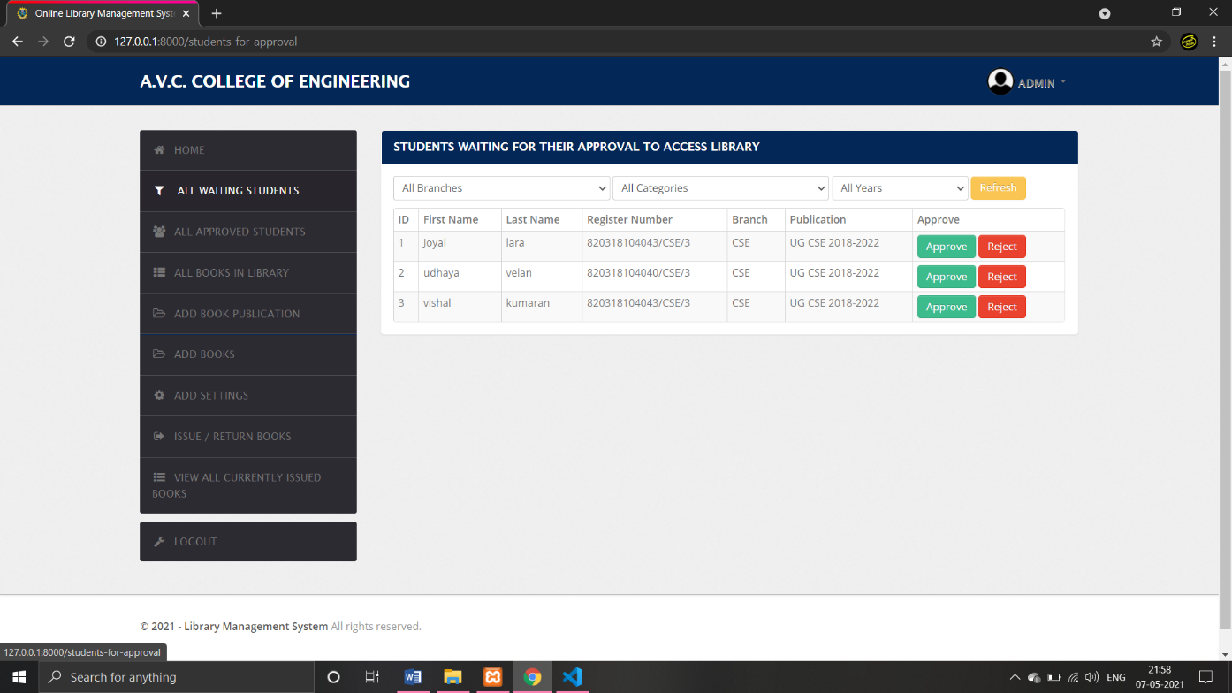
All Waiting Students page

Slide 24
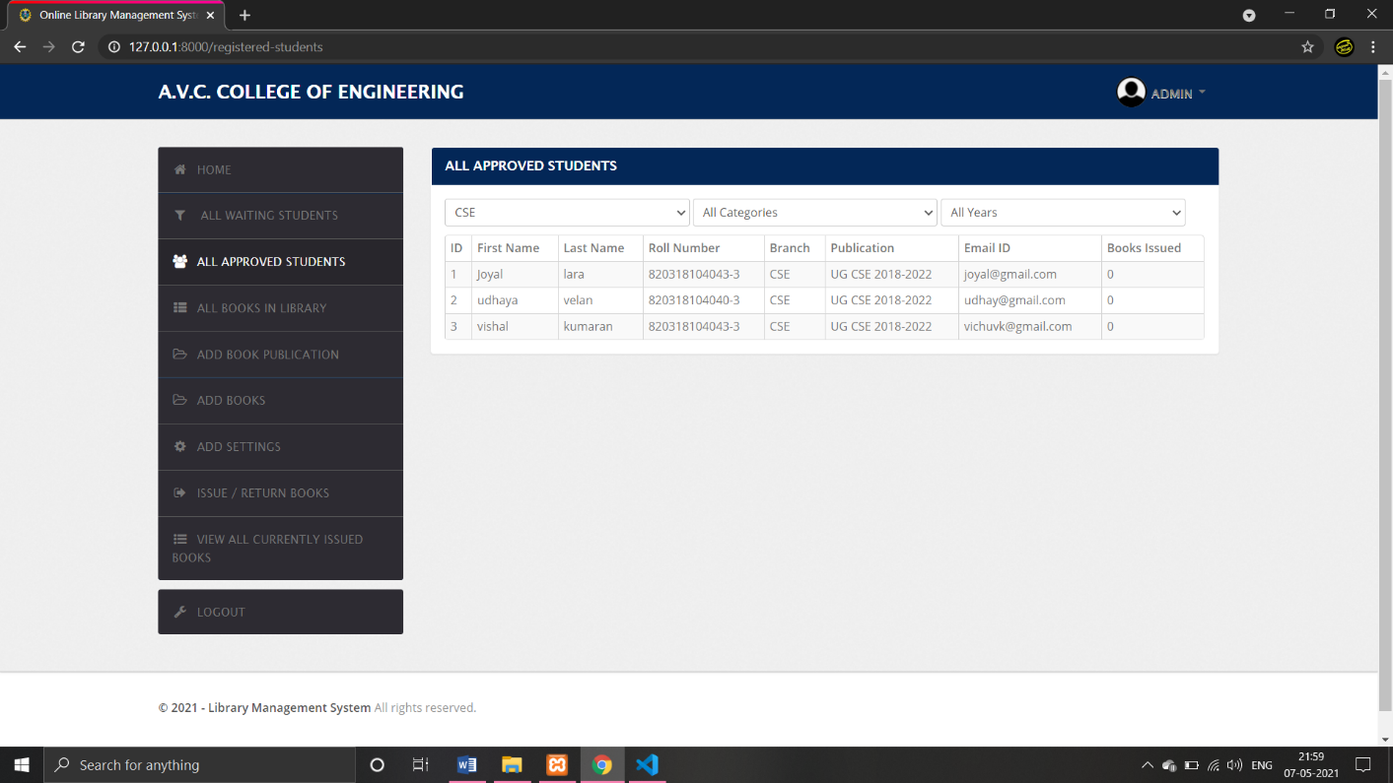
All Approved Students

Slide 25
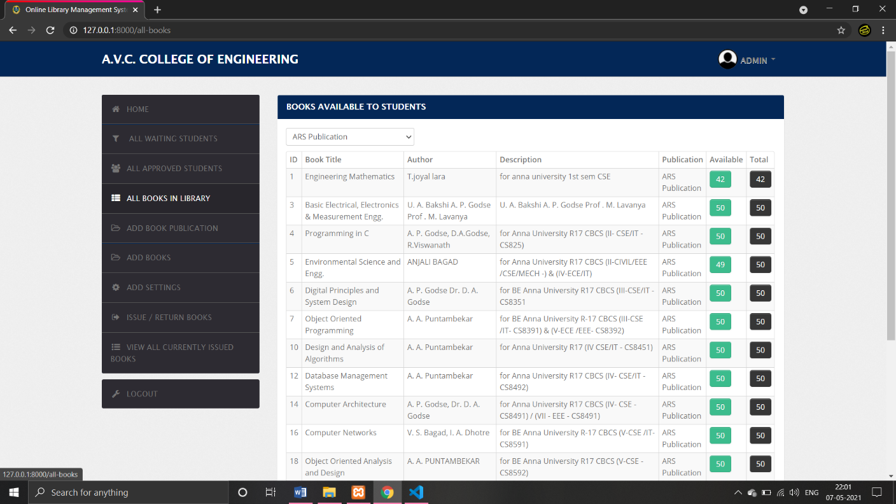
All Books in Library Page

Slide 26
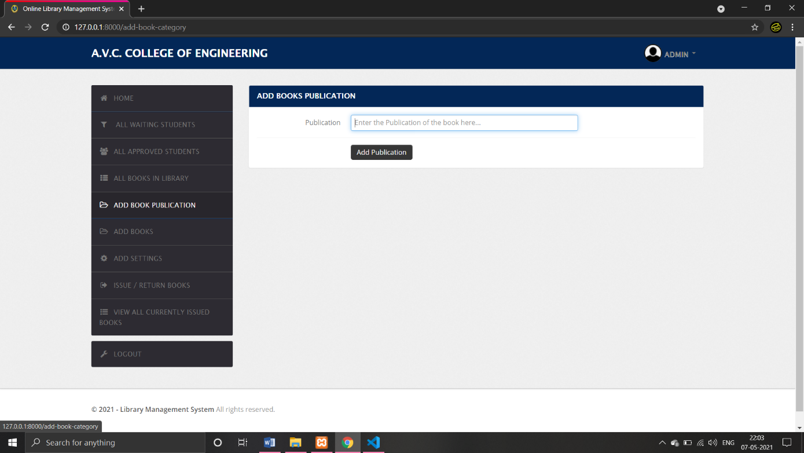
Add Book Publication Page

Slide 27
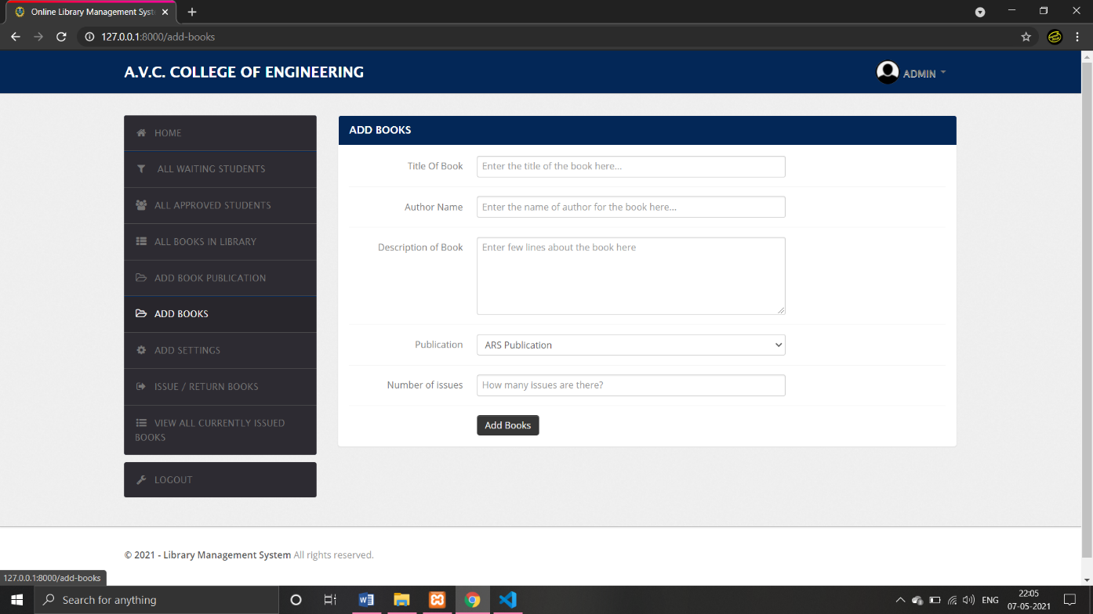
Add Books Page

Slide 28
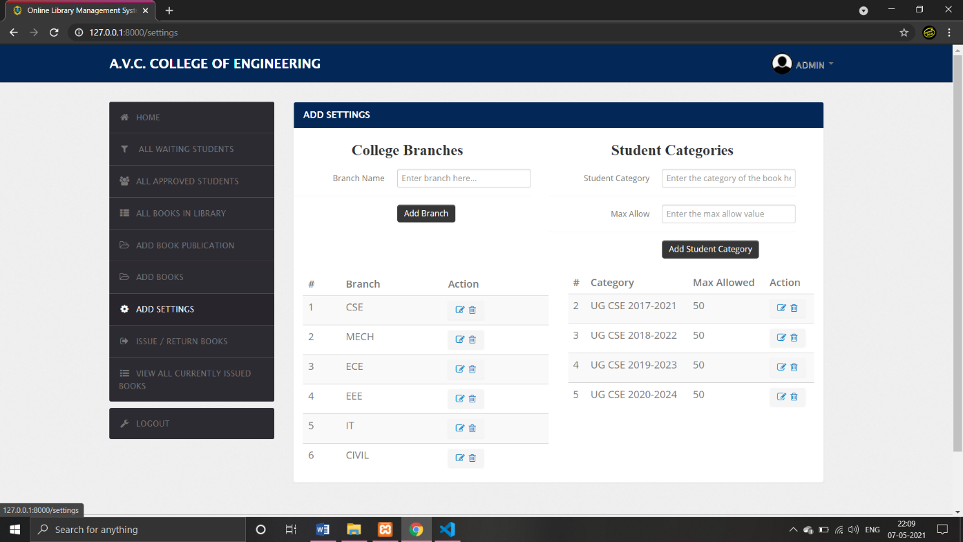
Add Settings page

Slide 29
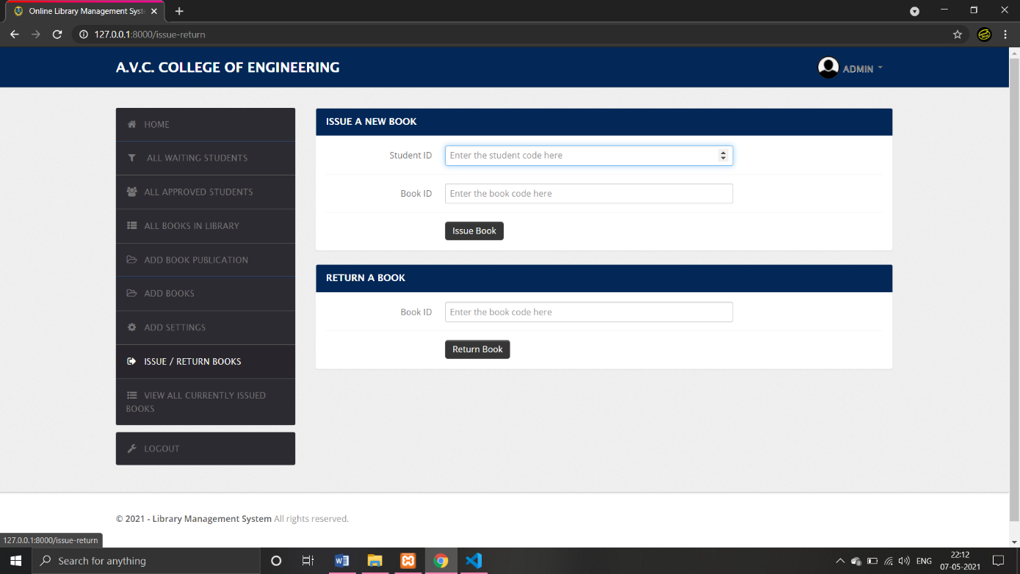
Issue Book/Return Book page

Slide 30
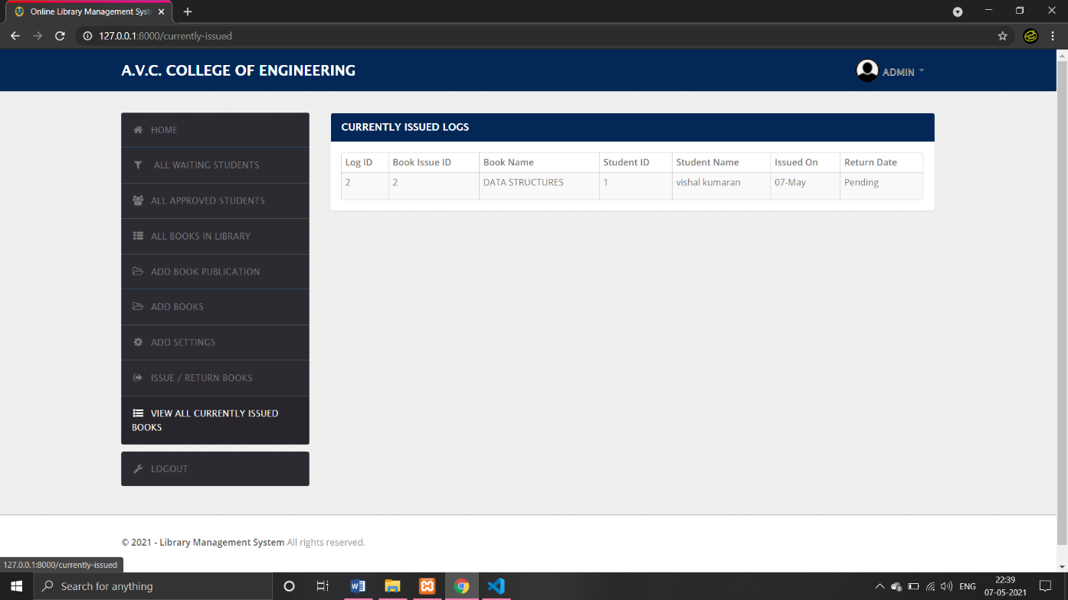
All Issued Book Page

Slide 31
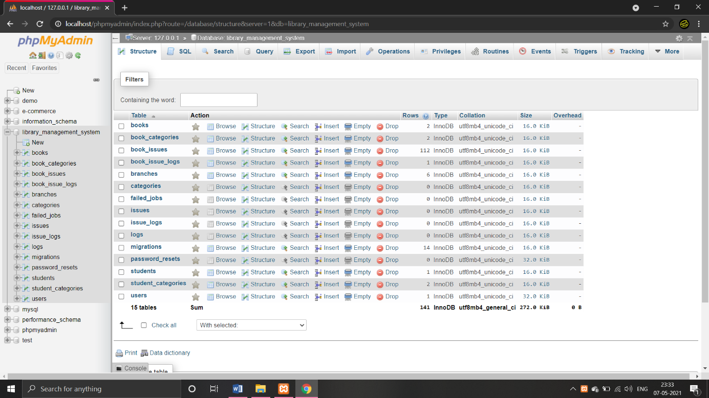
Database

Slide 32
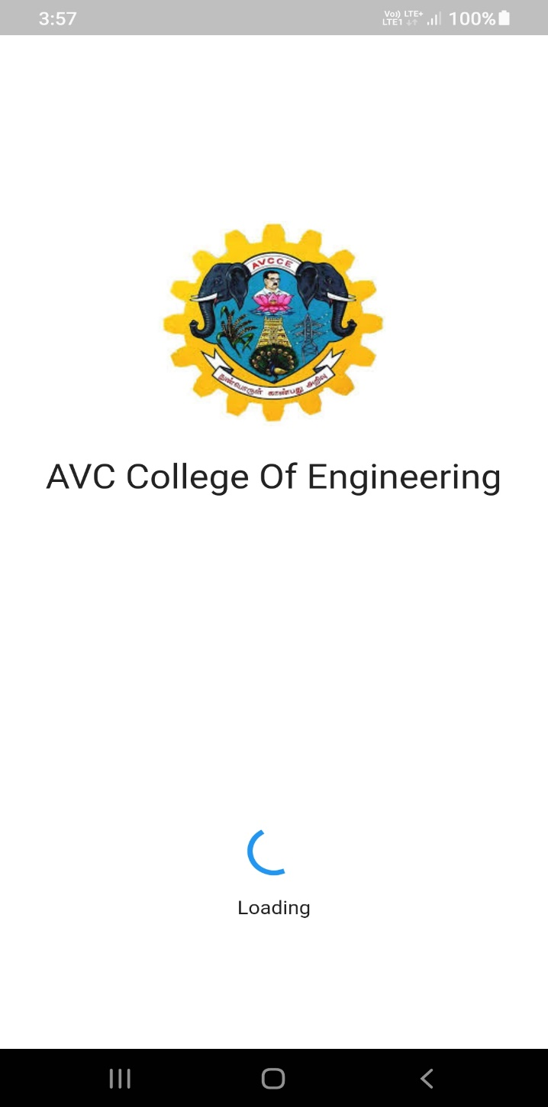
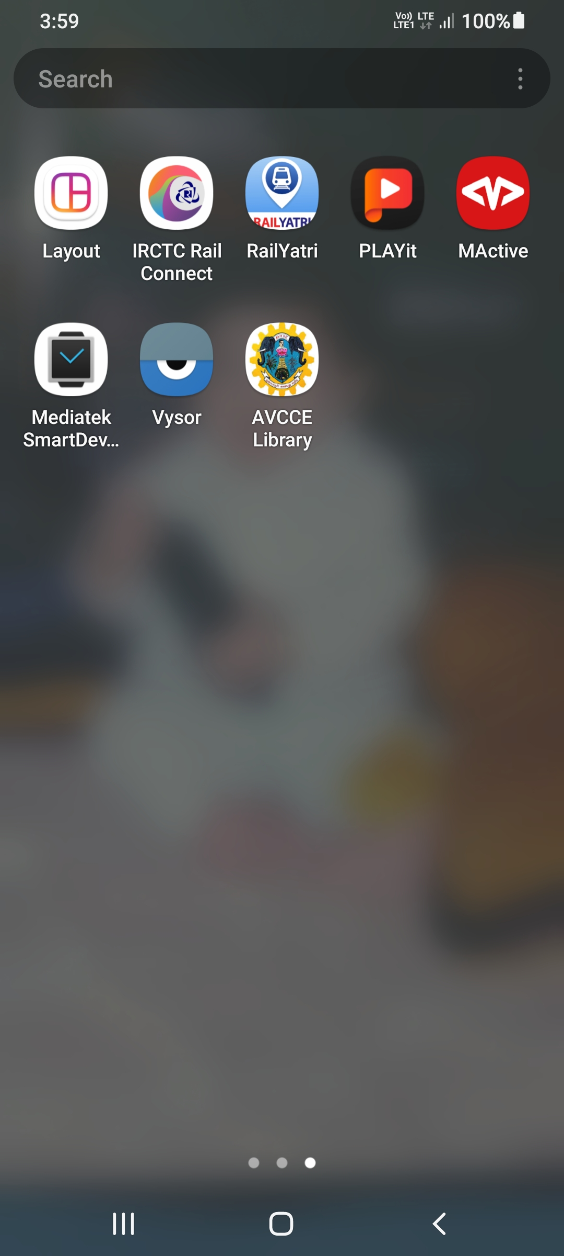
Mobile app icon Mobile app loading screen

Slide 33
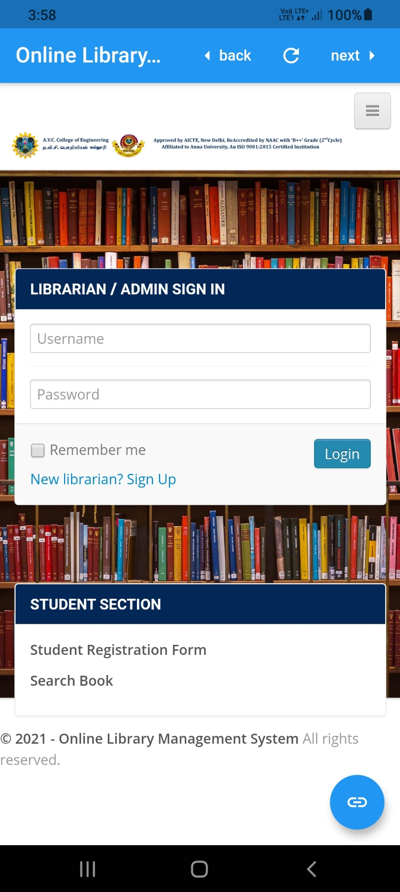
Mobile Application

Slide 34
REFERENCES
[1] Y. A. Anita Gade, Development of library management robotic system, International Conference on Data Management, Analytics and Innovation,2017
[2] H. S. Muhammad Ramadhan Fithian, Muamaroh, Developing a QR code-based library management with case study of private school in Surakarta city Indonesia, 2018
[3] N. S. K. S. N. T. M. N. I. Md. Mahmood Karim, Ashgate Zavin, A proposed multi-channel system for public libraries in bangladesh, ICAEE,2017
[4] J. F. Z. Chang Ji Wen, the university library management system based on radio frequency identification jinn,
[5] A. D. Liwen Liu, Management of an academic e-library project, International Conference on Information Management, Innovation Management and Industrial Engineering, vol. 54(8), pp. 62–71, 2011

